Slide 1



The Sound of Digital Transformation
NJ
TechnologEEE Arduino Program
TechnologEEE
Equip|Educate|Encourage

Slide 2

What is Digital Transformation?
NJ
Digital Transformation is the integration of digital technologies into all aspects of business and human society
TechnologEEE
Equip|Educate|Encourage
Notes:
AT&T – Analog switches and NFV
Digital Transformation also affects how businesses operate

Slide 3


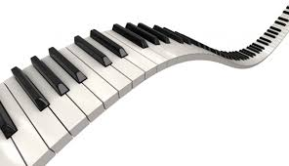
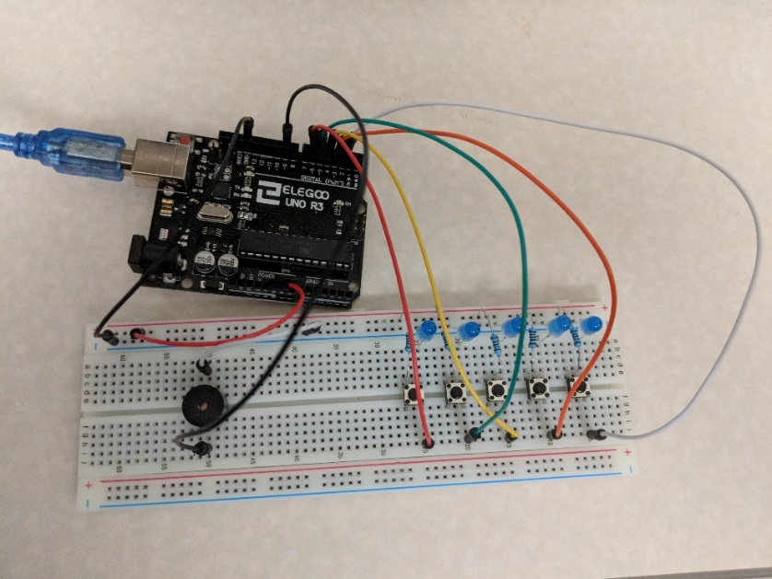
Exercise Introduction
NJ
Build a piano using the Arduino and button switches
Digitize the button switches in the program
TechnologEEE
Equip|Educate|Encourage

Slide 4
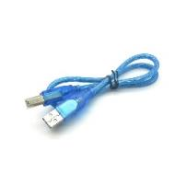
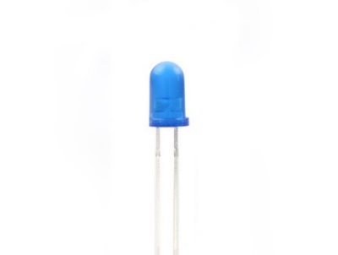
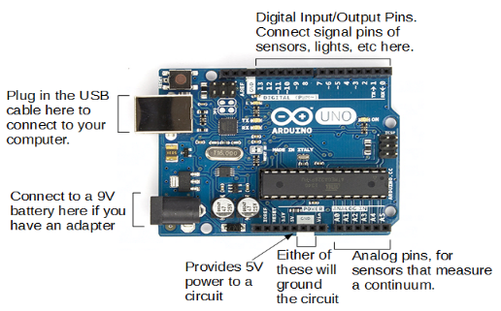
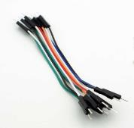
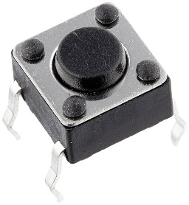
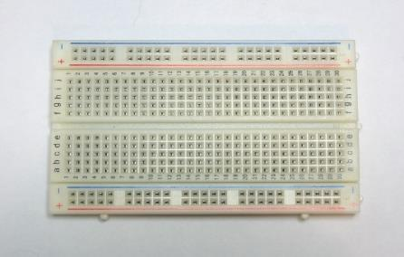
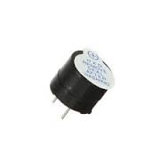
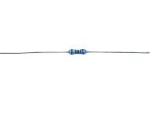
Materials
NJ
1 Arduino USB cable
Wires
5 100 Ohm resistor
(brown-black-black-black-brown)
1 Arduino Uno
1 breadboard
5 blue LEDs
5 Button Switches
1 active buzzer
TechnologEEE
Equip|Educate|Encourage

Slide 5
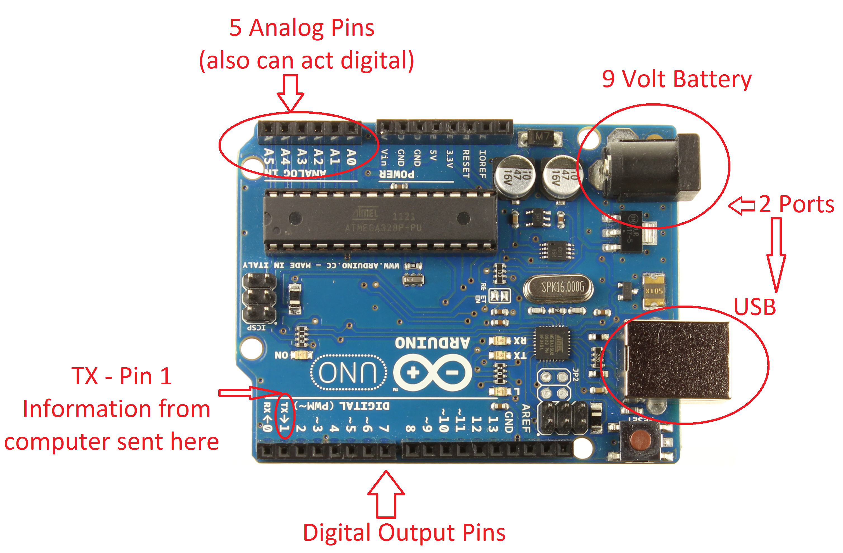
Arduino Intro
NJ
Arduino is an open-source electronics platform based on easy-to-use hardware and software.
It's intended for anyone making interactive projects.
TechnologEEE
Equip|Educate|Encourage

Slide 6
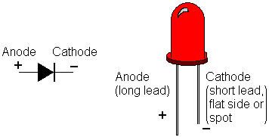
LED intro – Light Emitting Diode (LED)
NJ
TechnologEEE
Equip|Educate|Encourage
Notes:
Explain LEDs – Light emitting diode, more commonly known as an LED, that is a two lead semiconductor source. It is a p-n junction diode, which emits light when activated. More simply, if you put a power source to the right end, it will light up.
Explain/Identify cathode and anode – The cathode is the negative end and the anode is the positive end. You can tell which is which by identifying which is the shorter end and which is the longer end. The anode is the longer end and the positive side. The cathode is the shorter end and the negative side. This will be important for making the traffic light, so remember this. Maybe, make a pneumonic.
Tell kids to take LEDs and make a wider V (suggestion)

Slide 7
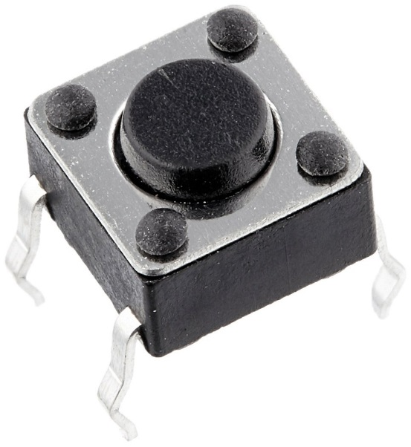
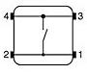
Button Switch Intro
NJ
Controls whether a circuit is open or closed, whether electricity flows through the circuit or not
Pressing the button means closing the switch, connecting 1-2 to 3-4
TechnologEEE
Equip|Educate|Encourage

Slide 8
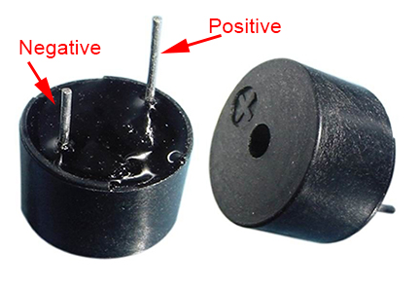
Active Buzzer Intro
NJ
When a DC voltage is applied, an oscillator is activated
An oscillator is a piece of material that vibrates when current flows through it
These vibrations make noise, just like your vocal chords
TechnologEEE
Equip|Educate|Encourage

Slide 9
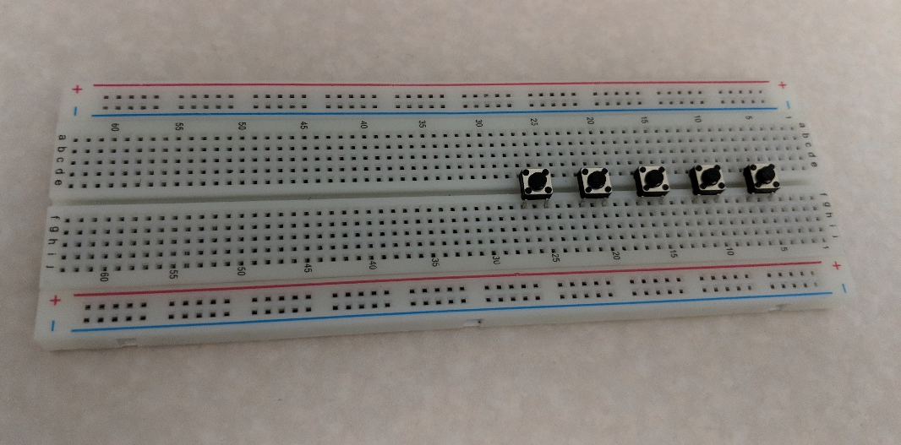
Adding the Switches
NJ
Place 5 buttons with their legs plugged into the following holes:
Button 1: e5, e7, f5, f7
Button 2: e10, e12, f10, f12
Button 3: e15, e17, f15, f17
Button 4: e20, e22, f20, f22
Button 5: e25, e27, f25, f27
TechnologEEE
Equip|Educate|Encourage

Slide 10
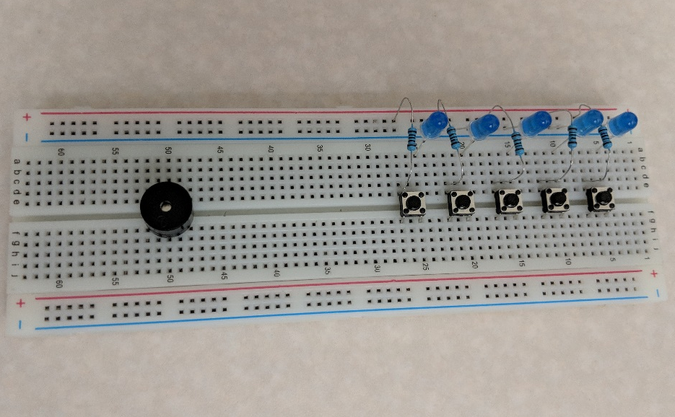
Creating Circuits
NJ
Connect resistors to the switch:
Place a resistor from (+)7 to d7
Place a resistor from (+)12 to d12
Place a resistor from (+)17 to d17
Place a resistor from (+)22 to d22
Place a resistor from (+)27 to d27
Connect LEDs to the switch:
LED1: short leg in (-)5, long leg in a5
LED2: short leg in (-)10, long leg in a10
LED3: short leg in (-)15, long leg in a15
LED4: short leg in (-)21, long leg in a20
LED4: short leg in (-)25, long leg in a25
TechnologEEE
Equip|Educate|Encourage

Slide 11
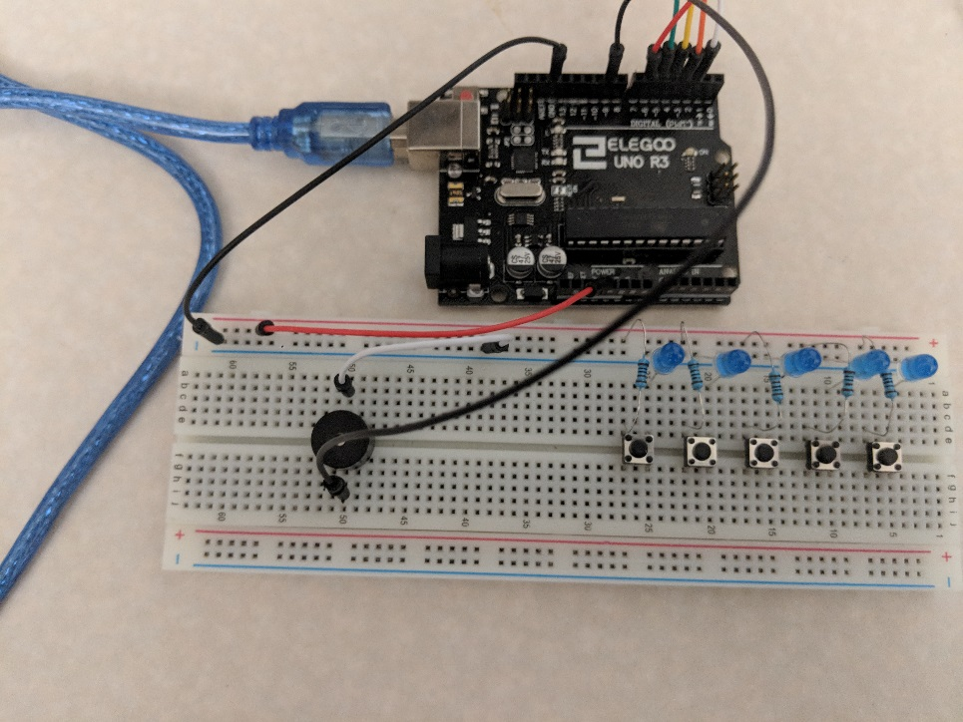
Adding the Buzzer
NJ
Buzzer: place the short end in e50, long end in f50
Connect Power and Ground:
Connect 5V on the Arduino to (+)55
Connect GND on the Arduino to (-)60
Connect digital 9 on the Arduino to i50
TechnologEEE
Equip|Educate|Encourage

Slide 12
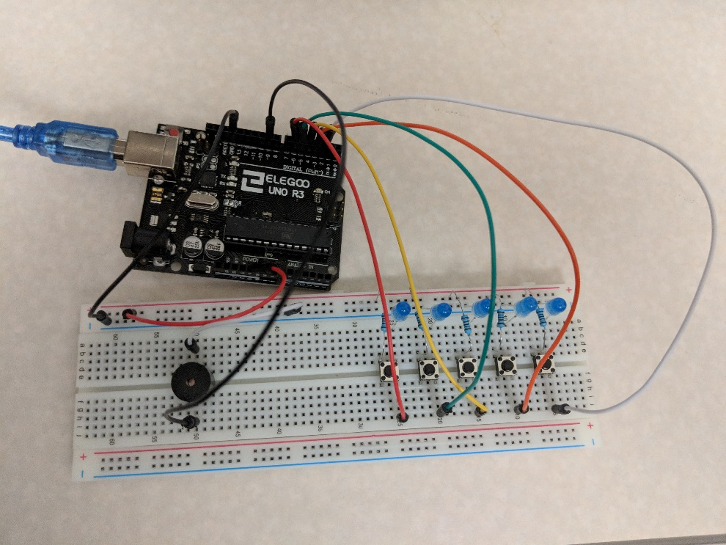
Adding Digital Inputs
NJ
Connect wires from the switches to the Arduino
Connect a wire from j5 to Arduino digital 2
Connect a wire from j10 to Arduino digital 3
Connect a wire from j15 to Arduino digital 4
Connect a wire from j20 to Arduino digital 5
Connect a wire from j25 to Arduino digital 6
TechnologEEE
Equip|Educate|Encourage

Slide 13
Uploading the Code
NJ
Plug the Arduino into the laptop with the USB cable
Open “piano.ino”
Map the COM port to the Arduino and upload the code
Can modify the code to change the frequencies
TechnologEEE
Equip|Educate|Encourage

Slide 14
Digitizing the Piano Setup
NJ
Open “piezo.ino”
Upload the code to the Arduino
TechnologEEE
Equip|Educate|Encourage

Slide 15
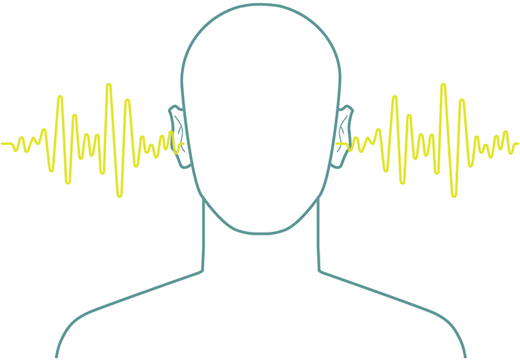
Sample Discussion Questions
NJ
Can you think of any ways you can further digitize this piano setup?
What are the benefits of having the digital setup vs the analog? What are the challenges?
Can you think how this transition to digital technologies affect the way businesses operate?
TechnologEEE
Equip|Educate|Encourage

